Slide 1

Object Oriented Programming Windows Tutorials Tutorial #1 : Prepare a Bitmap
Department of Computer Science and Information Engineering
Shuo-Han Chen (陳碩漢), shchen@csie.ntut.edu.tw
Hong-Yue Technology Research Building 1223
F 09:10 - 12:00
Notes:
Good Afternoon everyone
I am Shuo-Han Chen, a postdoctoral research fellow at Academia Sinica
It is a great honor to be invited by the department for being here today

Slide 2

Part I.
Game Framework 4.10使用說明 Visual Studio 2017
練習1A ：使用手繪或剪貼方式在 Game 的 Resource 中建立一張新的點陣圖
Notes:
Thank you for listening. Now, I would like to end today’s talk by the Q & A time.

Slide 3
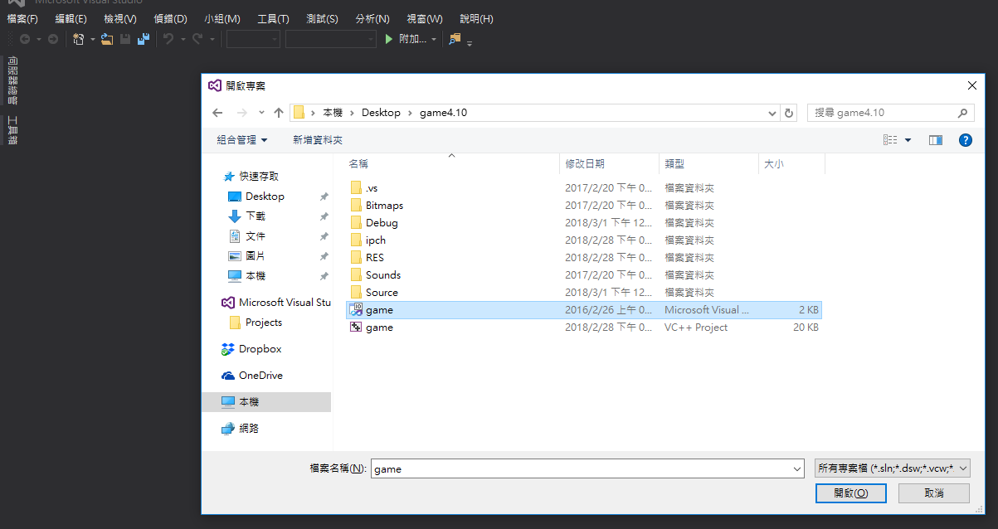
1.雙擊 Game.sln 開啟 game
選取 Create a project 來建立一個新的專案

Slide 4
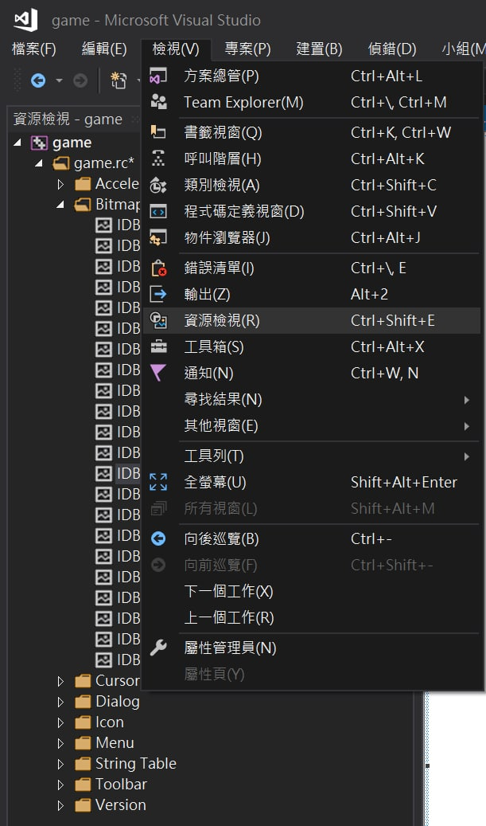
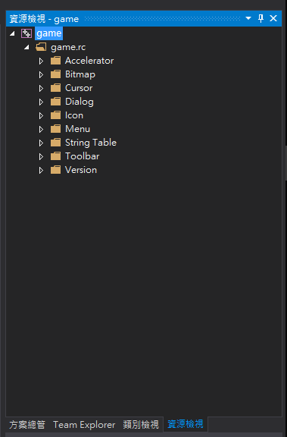
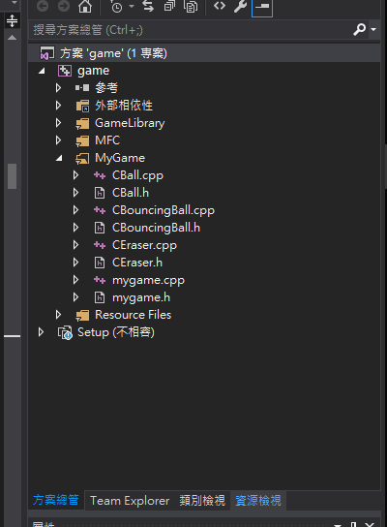
2.成功開啟之後，到「檢視」中，選擇「資源檢視」，並點擊game --> game.rc ，可以看到現在遊戲中使用的資源。

Slide 5
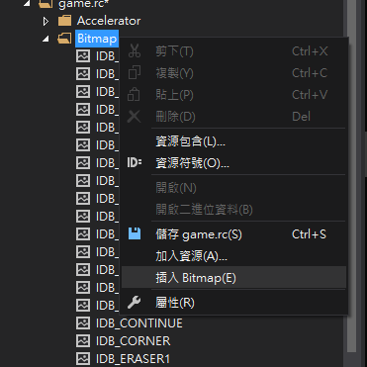
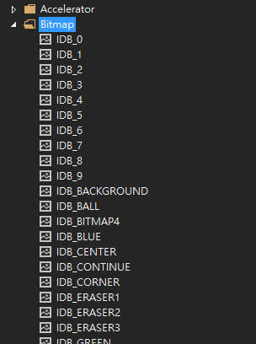
3.在點開Bitmap 資料夾，可以看到當下遊戲使用的點陣圖，在 Bitmap 按右鍵，選擇「插入 Bitmap 」，之後會出現一個空白的 Bitmap ，可以在資源欄中找到。

Slide 6
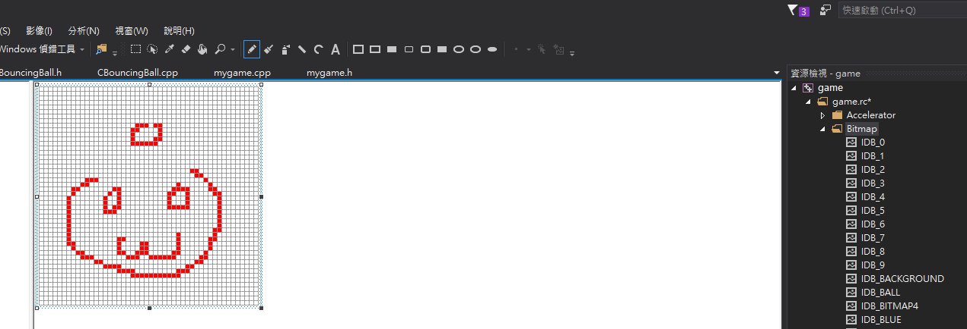
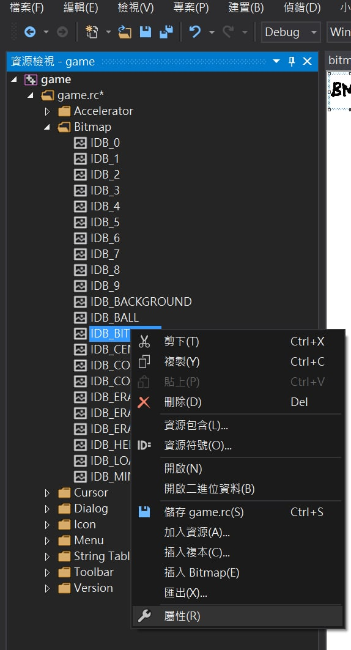
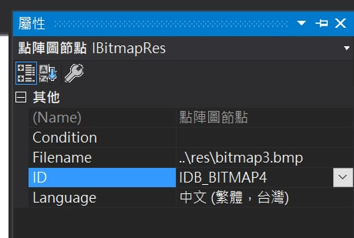
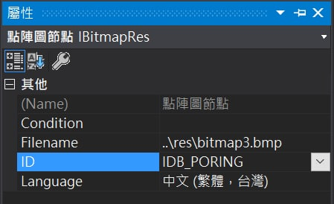
4.畫上你的點陣圖（或是你從其他地方複製圖片到空白點陣圖上），按下儲存，並點擊圖片檔按右鍵，在右邊的屬性視窗中自訂圖片的 ID 。（注意格式！）

Slide 7
Part II.
Game Framework 4.10使用說明 Visual Studio 2017
練習1B ：使用匯入方式在 Game 的 Resource 中建立一張新的點陣圖
Notes:
Thank you for listening. Now, I would like to end today’s talk by the Q & A time.

Slide 8
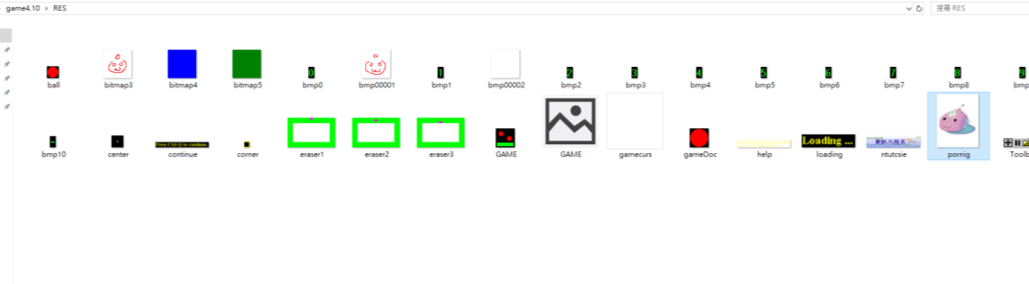
1.先將想要放入遊戲的點陣圖，放入專案底下 。
（此處 示範 為放在 RES 中）
8
Notes:
Here is more detail about me. I started working as a postdoctoral research fellow at the Institute of Information Science, Academia Sinica since March 2018
During my fellowship, I have been to the Purdue University USA and the Chinese University of Hong Kong for visiting
Before my fellowship, I spent two and half years for my phd degree at the CS Department of National Tsing Hua University
My research interests mainly lies in
the next generation memory/storage architecture designs
Emerging non-volatile memory and storage technologies
Low power system designs for artificial neural networks
In the past few years, I have revived few awards and a best paper nomination at DAC conference, which is a top rated conference in the EDA field

Slide 9
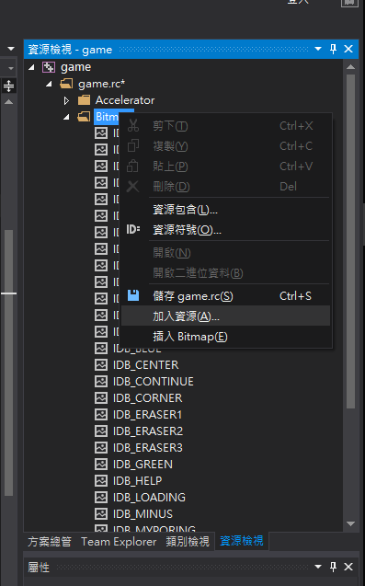
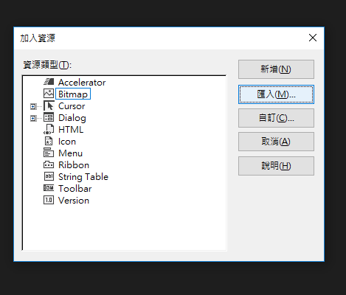
2.在 「資源檢視」 欄內 Bitmap 上按右鍵選擇 「加入資源」， 資源類型選擇 Bitmap並按下 「匯入」。
9
Notes:
Here is more detail about me. I started working as a postdoctoral research fellow at the Institute of Information Science, Academia Sinica since March 2018
During my fellowship, I have been to the Purdue University USA and the Chinese University of Hong Kong for visiting
Before my fellowship, I spent two and half years for my phd degree at the CS Department of National Tsing Hua University
My research interests mainly lies in
the next generation memory/storage architecture designs
Emerging non-volatile memory and storage technologies
Low power system designs for artificial neural networks
In the past few years, I have revived few awards and a best paper nomination at DAC conference, which is a top rated conference in the EDA field

Slide 10
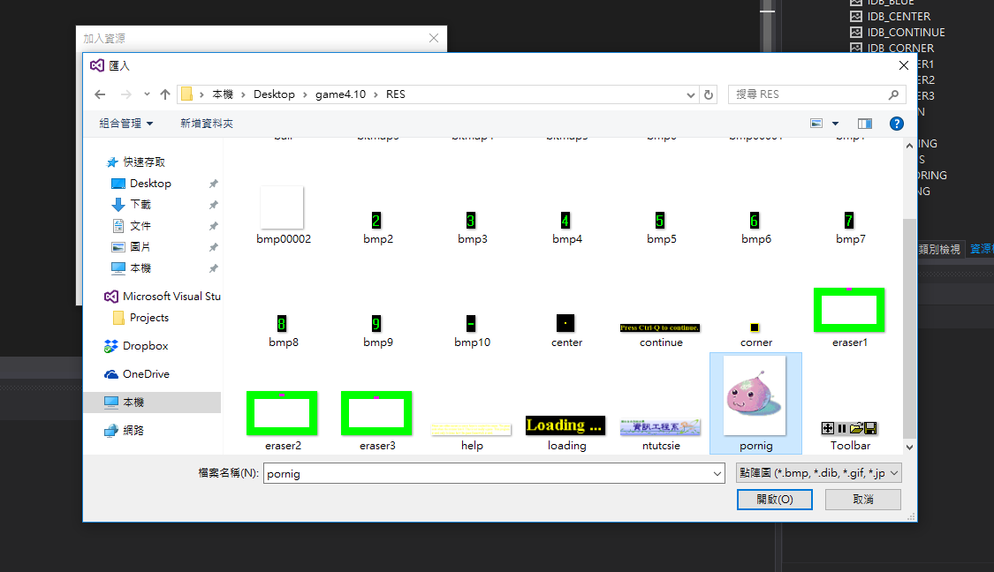
3.選擇 剛剛 放入專案 的圖片路徑 ，並按下開啟鍵。
10
Notes:
Here is more detail about me. I started working as a postdoctoral research fellow at the Institute of Information Science, Academia Sinica since March 2018
During my fellowship, I have been to the Purdue University USA and the Chinese University of Hong Kong for visiting
Before my fellowship, I spent two and half years for my phd degree at the CS Department of National Tsing Hua University
My research interests mainly lies in
the next generation memory/storage architecture designs
Emerging non-volatile memory and storage technologies
Low power system designs for artificial neural networks
In the past few years, I have revived few awards and a best paper nomination at DAC conference, which is a top rated conference in the EDA field

Slide 11
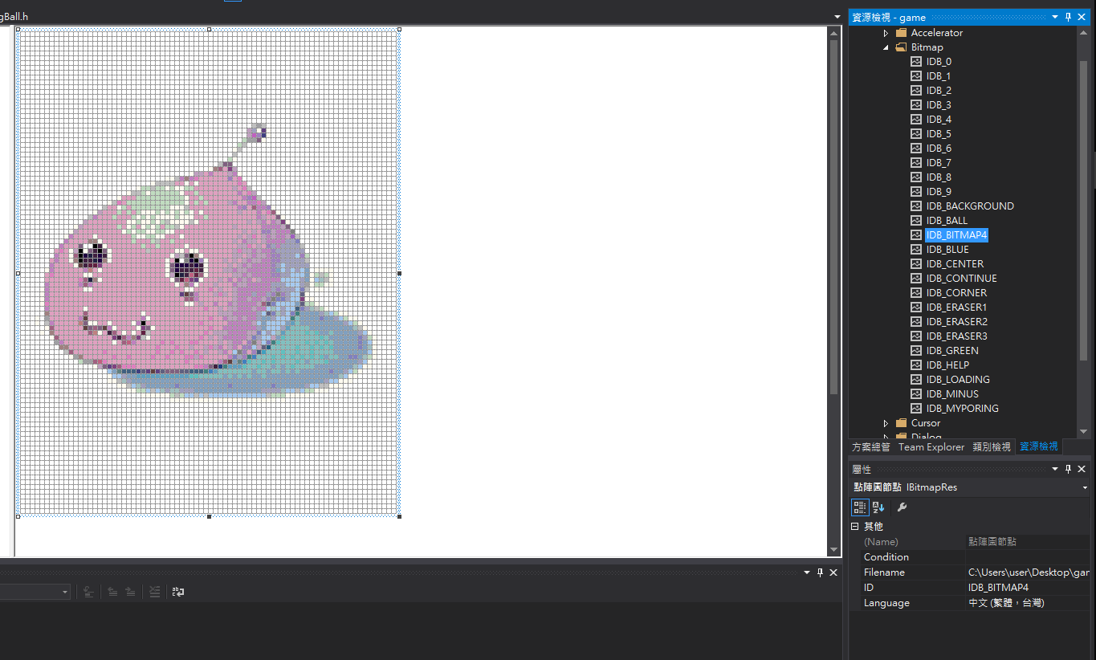
4.利用 1A 所介紹的方法，找到目標圖片， 點擊右方圖片檔案一下，在下列屬性視窗中自訂圖片的 ID 。
11
Notes:
Here is more detail about me. I started working as a postdoctoral research fellow at the Institute of Information Science, Academia Sinica since March 2018
During my fellowship, I have been to the Purdue University USA and the Chinese University of Hong Kong for visiting
Before my fellowship, I spent two and half years for my phd degree at the CS Department of National Tsing Hua University
My research interests mainly lies in
the next generation memory/storage architecture designs
Emerging non-volatile memory and storage technologies
Low power system designs for artificial neural networks
In the past few years, I have revived few awards and a best paper nomination at DAC conference, which is a top rated conference in the EDA field

Slide 12
Part III.
練習1C：直接將點陣圖(bmp 檔)放在Game 的目錄下
Notes:
Thank you for listening. Now, I would like to end today’s talk by the Q & A time.

Slide 13
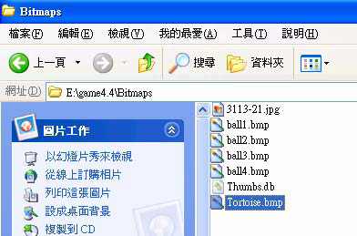
1.假設在game 裡面想要使用Tortoise.bmp 檔(限用bmp 檔)，則將此圖檔拷貝在專案的目錄下的圖片資料夾中，
(這裡以E:\game4.4\Bitmaps 為例，E:\game4.4 為專案目錄而 Bitmaps 為存放圖片的資料夾)。備註：一定要拷貝進來，不能放在專案目錄之外，否則，遊戲完成後，會無法部署至其他電腦。

